Slide 1
Introduction of Generative Adversarial Network (GAN)
Shangsong Liang
Sun Yat-sen University
Notes:
Produced by Hung-yi Lee
Q: 可以做得很好? 為什麼?
Q: VAE 為何不好?
Q: unroll GAN有用嗎？

Slide 2

Generative Adversarial Network (GAN)
How to pronounce “GAN”?

Slide 3

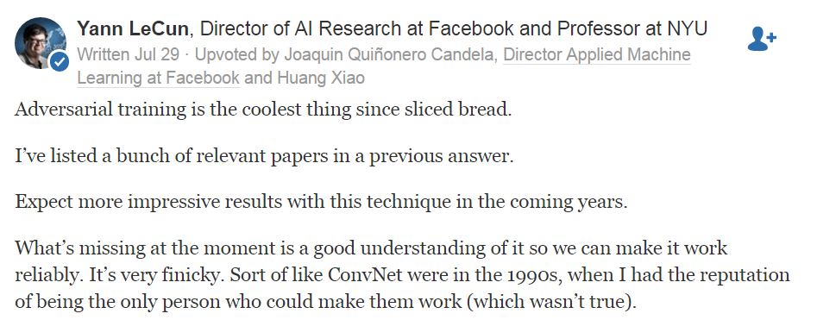
Yann LeCun’s comment
https://www.quora.com/What-are-some-recent-and-potentially-upcoming-breakthroughs-in-unsupervised-learning

Slide 4
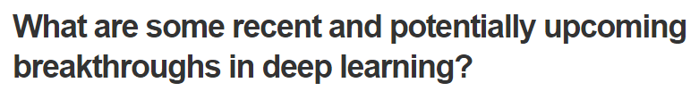
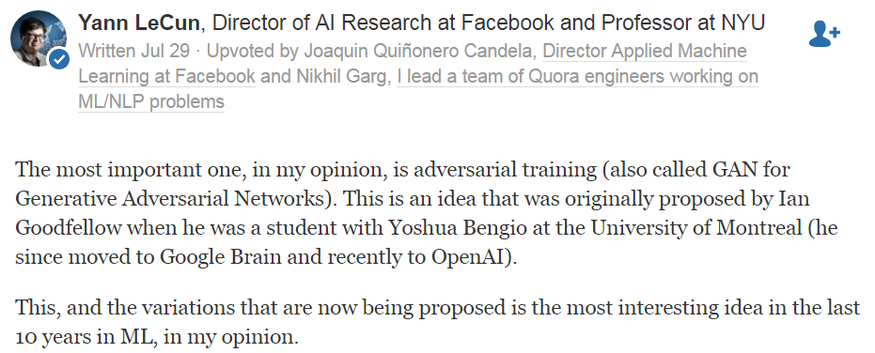
Yann LeCun’s comment
……
https://www.quora.com/What-are-some-recent-and-potentially-upcoming-breakthroughs-in-deep-learning

Slide 5
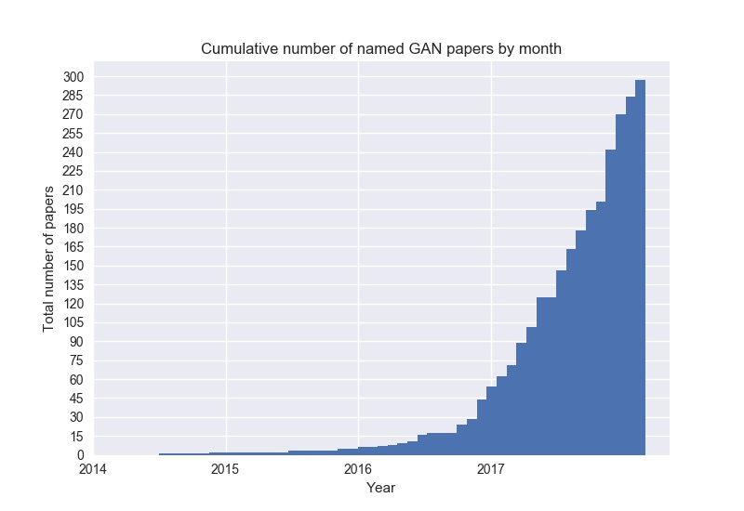
All Kinds of GAN …
https://github.com/hindupuravinash/the-gan-zoo
GAN
ACGAN
BGAN
CGAN
DCGAN
EBGAN
fGAN
GoGAN
……
Mihaela Rosca, Balaji Lakshminarayanan, David Warde-Farley, Shakir Mohamed, “Variational Approaches for Auto-Encoding Generative Adversarial Networks”, arXiv, 2017
Notes:
DeepMind

Slide 6
ICASSP
Keyword search on session index page, so session names are included.
Number of papers whose titles include the keyword
GAN becomes a very important technology.

Slide 7
Outline
Basic Idea of GAN
GAN as structured learning
Can Generator learn by itself?
Can Discriminator generate?
A little bit theory

Slide 8



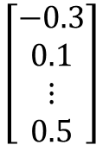
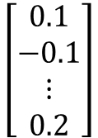
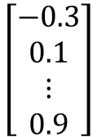
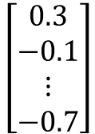
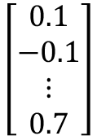
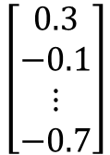
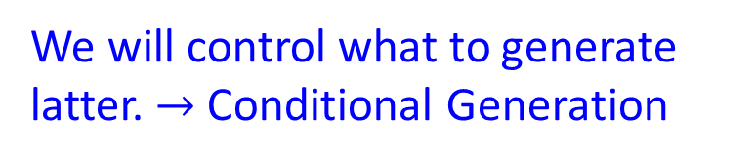
Generation
We will control what to generate latter. $→$ Conditional Generation
Image Generation
$$\left[\begin{aligned}0.3 \\ −0.1 \\ ⋮ \\ −0.7\end{aligned}\right]$$
$$\left[\begin{aligned}0.1 \\ −0.1 \\ ⋮ \\ 0.7\end{aligned}\right]$$
$$\left[\begin{aligned}−0.3 \\ 0.1 \\ ⋮ \\ 0.9\end{aligned}\right]$$
NN
Generator
In a specific range
Sentence Generation
$$\left[\begin{aligned}0.3 \\ −0.1 \\ ⋮ \\ −0.7\end{aligned}\right]$$
$$\left[\begin{aligned}0.1 \\ −0.1 \\ ⋮ \\ 0.2\end{aligned}\right]$$
$$\left[\begin{aligned}−0.3 \\ 0.1 \\ ⋮ \\ 0.5\end{aligned}\right]$$
NN
Generator
How are you?
Good morning.
Good afternoon.

Slide 9








Basic Idea of GAN
Powered by: http://mattya.github.io/chainer-DCGAN/
It is a neural network (NN), or a function.
Generator
high dimensional vector
image
vector
$$\left[\begin{aligned}0.1 \\ −3 \\ ⋮ \\ 2.4 \\ 0.9\end{aligned}\right]$$
$$\left[\begin{aligned}3 \\ −3 \\ ⋮ \\ 2.4 \\ 0.9\end{aligned}\right]$$
Generator
Generator
Each dimension of input vector represents some characteristics.
Longer hair
$$\left[\begin{aligned}0.1 \\ 2.1 \\ ⋮ \\ 5.4 \\ 0.9\end{aligned}\right]$$
$$\left[\begin{aligned}0.1 \\ −3 \\ ⋮ \\ 2.4 \\ 3.5\end{aligned}\right]$$
Generator
Generator
blue hair
Open mouth

Slide 10



Basic Idea of GAN
It is a neural network (NN), or a function.
Discri-minator
scalar
image
Larger value means real, smaller value means fake.
Discri-minator
Discri-minator
1.0
1.0
Discri-minator
Discri-minator
0.1
0.1

Slide 11
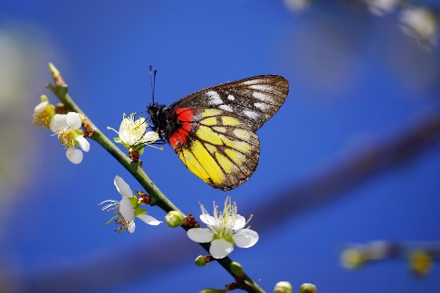
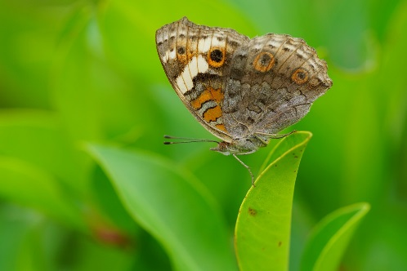
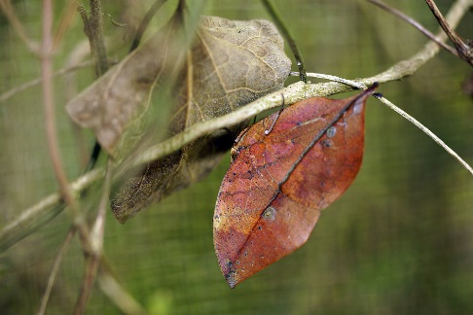
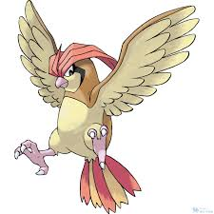
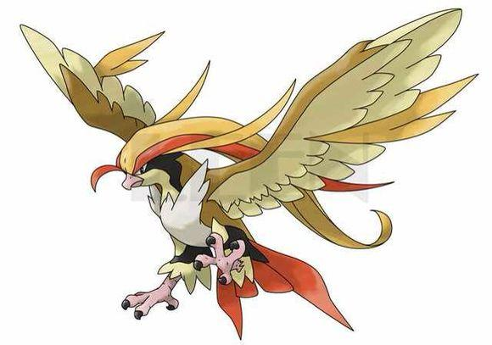
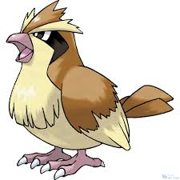
Basic Idea of GAN
Generator
Brown
veins
Butterflies are not brown
Butterflies do not have veins
……..
Discriminator
Notes:
http://peellden.pixnet.net/blog/post/40406899-2013-%E7%AC%AC%E5%9B%9B%E5%AD%A3%EF%BC%8C%E5%86%AC%E8%9D%B6%E5%AF%82%E5%AF%A5
Kallima inachus
Vein
dried leaf

Slide 12





Basic Idea of GAN
This is where the term “adversarial” comes from.
You can explain the process in different ways…….
NN
Generator
v1
NN
Generator
v2
NN
Generator
v3
Discri-minator
v1
Discri-minator
v2
Discri-minator
v3
Real images:
Notes:
Binary
Classifier

Slide 13

Basic Idea of GAN
(和平的比喻)
Generator
(student)
Discriminator
(teacher)
Generator
v1
Discriminator
v1
沒有兩個圈
Generator
v2
Discriminator
v2
沒有彩色
Generator
v3
為什麼不自己學？
為什麼不自己做？

Slide 14
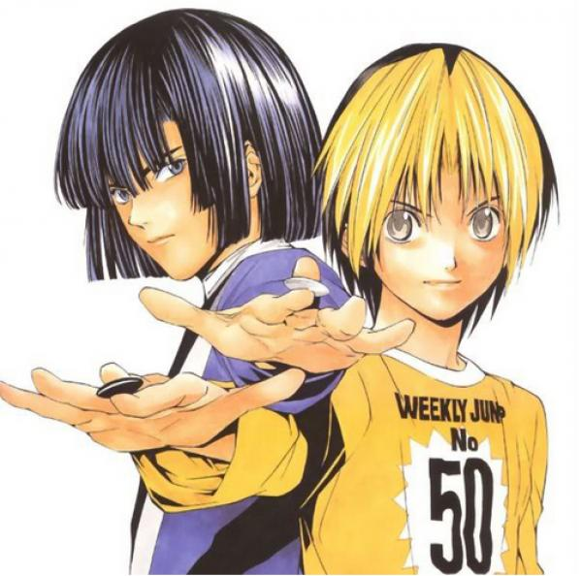
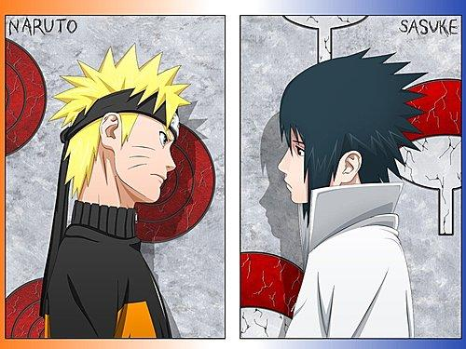
Generator v.s. Discriminator
寫作敵人，唸做朋友

Slide 15







Algorithm
G
D
Initialize generator and discriminator
In each training iteration:
Step 1: Fix generator G, and update discriminator D
sample
Update
1
1
1
1
D
generated objects
Database
0
0
0
0
randomly sampled
G
vector
Fix
vector
vector
vector
Discriminator learns to assign high scores to real objects and low scores to generated objects.

Slide 16


Algorithm
G
D
Initialize generator and discriminator
In each training iteration:
Step 2: Fix discriminator D, and update generator G
Generator learns to “fool” the discriminator
hidden layer
NN
Generator
Discri-minator
0.13
vector
update
fix
Gradient Ascent
large network

Slide 17
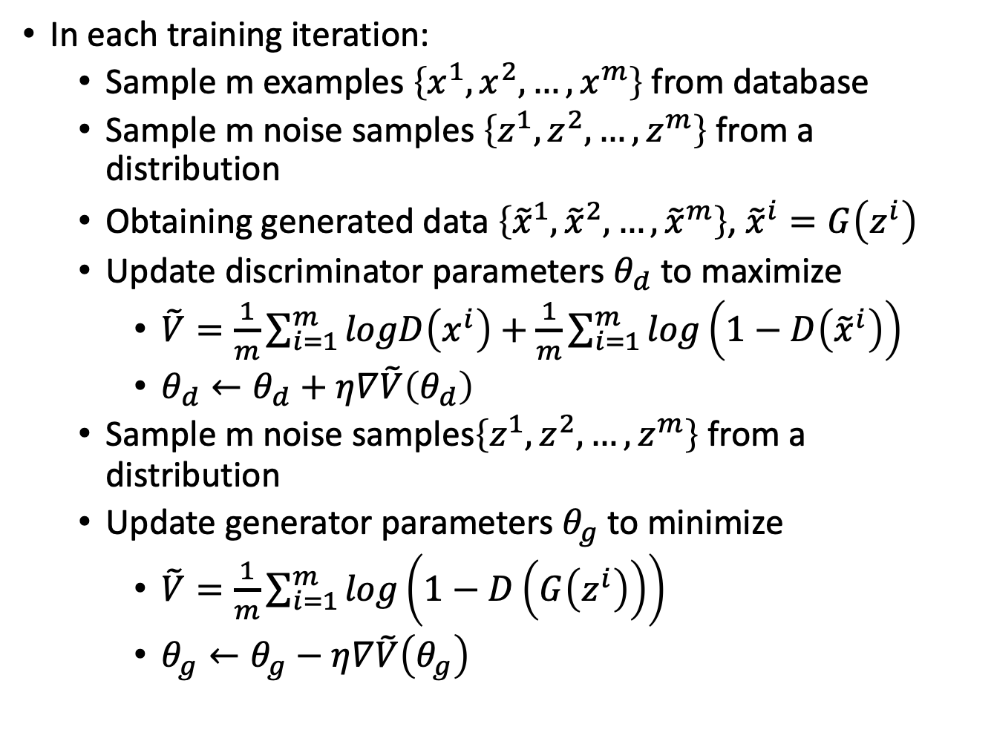
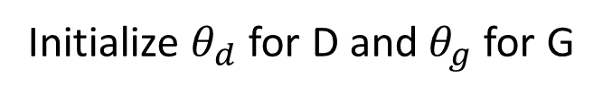
Algorithm
Initialize $θ_{d}$ for D and $θ_{g}$ for G
In each training iteration:
  Sample m examples $\left\{x^{1},x^{2},…,x^{m}\right\}$ from database
  Sample m noise samples $\left\{z^{1},z^{2},…,z^{m}\right\}$ from a distribution
  Obtaining generated data $\left\{{\tilde{x}}^{1},{\tilde{x}}^{2},…,{\tilde{x}}^{m}\right\}$, ${\tilde{x}}^{i}=G\left(z^{i}\right)$
  Update discriminator parameters $θ_{d}$ to maximize
    $\tilde{V}=\frac{1}{m}\sum_{i=1}^{m}{logD\left(x^{i}\right)}+\frac{1}{m}\sum_{i=1}^{m}{log\left(1−D\left({\tilde{x}}^{i}\right)\right)}$
    $θ_{d}←θ_{d}+η∇\tilde{V}\left(θ_{d}\right)$
  Sample m noise samples$\left\{z^{1},z^{2},…,z^{m}\right\}$ from a distribution
  Update generator parameters $θ_{g}$ to minimize
    $\tilde{V}=\frac{1}{m}\sum_{i=1}^{m}{log\left(1−D\left(G\left(z^{i}\right)\right)\right)}$
    $θ_{g}←θ_{g}−η∇\tilde{V}\left(θ_{g}\right)$
Learning
D
Learning
G
Notes:
位什麼要 1- 啊

Slide 18
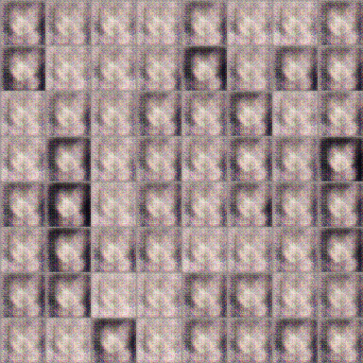
Anime Face Generation
100 updates
Source of training data: https://zhuanlan.zhihu.com/p/24767059

Slide 19
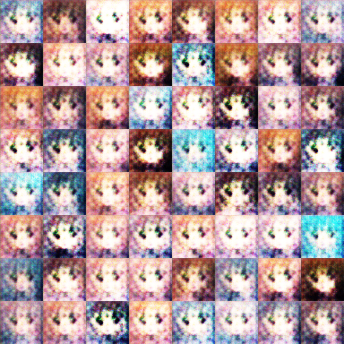
Anime Face Generation
1000 updates

Slide 20
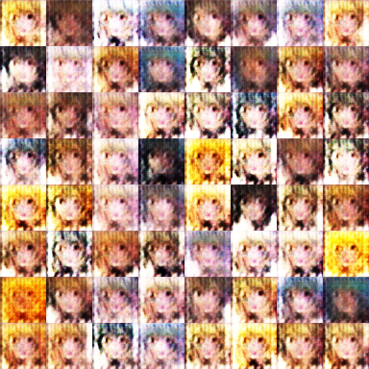
Anime Face Generation
2000 updates

Slide 21
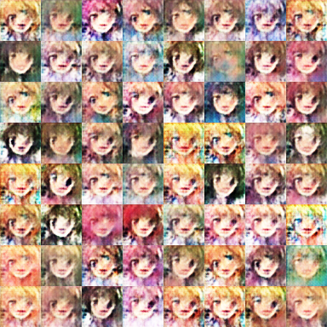
Anime Face Generation
5000 updates

Slide 22
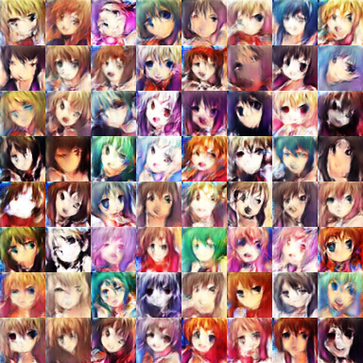
Anime Face Generation
10,000 updates

Slide 23
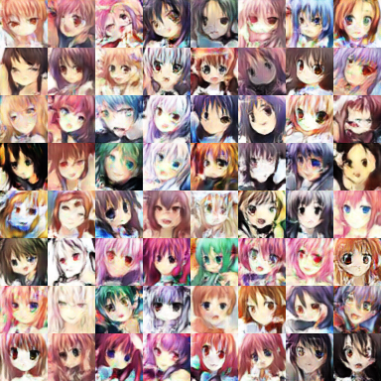
Anime Face Generation
20,000 updates

Slide 24
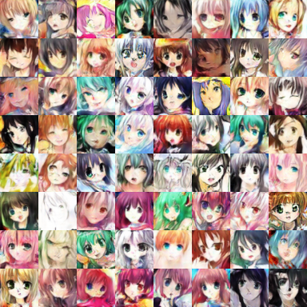
Anime Face Generation
50,000 updates

Slide 25
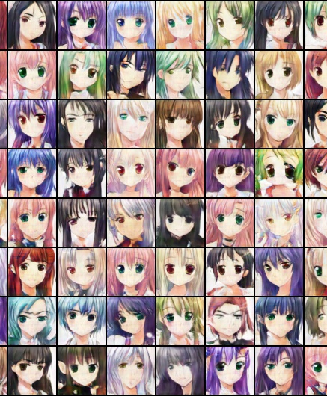
The faces generated by machine.
圖片生成：
吳宗翰、謝濬丞、
陳延昊、錢柏均
Notes:
圖片生成：
吳宗翰、謝濬丞、
陳延昊、錢柏均

Slide 26





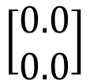
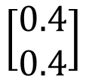
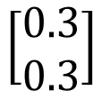
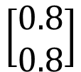
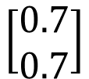
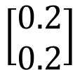
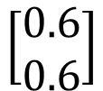
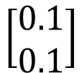
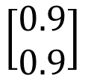
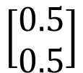
G
G
G
G
G
G
G
G
G
G
$$\left[\begin{aligned}0.0 \\ 0.0\end{aligned}\right]$$
$$\left[\begin{aligned}0.1 \\ 0.1\end{aligned}\right]$$
$$\left[\begin{aligned}0.2 \\ 0.2\end{aligned}\right]$$
$$\left[\begin{aligned}0.3 \\ 0.3\end{aligned}\right]$$
$$\left[\begin{aligned}0.4 \\ 0.4\end{aligned}\right]$$
$$\left[\begin{aligned}0.5 \\ 0.5\end{aligned}\right]$$
$$\left[\begin{aligned}0.6 \\ 0.6\end{aligned}\right]$$
$$\left[\begin{aligned}0.7 \\ 0.7\end{aligned}\right]$$
$$\left[\begin{aligned}0.8 \\ 0.8\end{aligned}\right]$$
$$\left[\begin{aligned}0.9 \\ 0.9\end{aligned}\right]$$
感謝陳柏文同學提供實驗結果

Slide 27
Outline
Basic Idea of GAN
GAN as structured learning
Can Generator learn by itself?
Can Discriminator generate?
A little bit theory

Slide 28
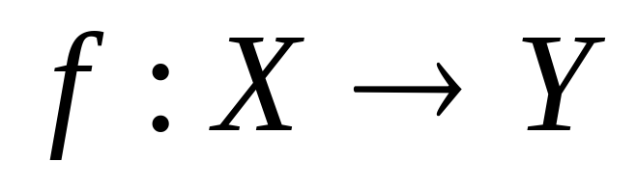
Structured Learning
Machine learning is to find a function f
Regression: output a scalar
Classification: output a “class”
(one-hot vector)
1 | 0 | 0
0 | 1 | 0
0 | 0 | 1
Class 1
Class 2
Class 3
Structured Learning/Prediction: output a sequence, a matrix, a graph, a tree ……
Output is composed of components with dependency
Notes:
Just name a few
Take human language processing and image processing as examples

Slide 29
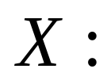
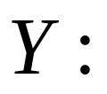
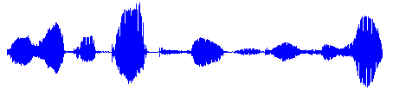
Output Sequence
Machine Translation
“機器學習及其深層與結構化”
“Machine learning and having it deep and structured”
(sentence of language 1)
(sentence of language 2)
Speech Recognition
感謝大家來上課”
(speech)
(transcription)
Chat-bot
“How are you?”
“I’m fine.”
(what a user says)
(response of machine)
Notes:
課程名稱只能有12 個字

Slide 30
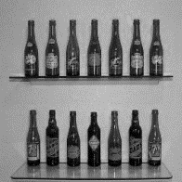
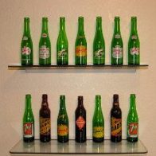
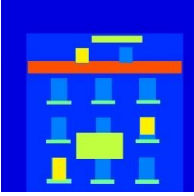
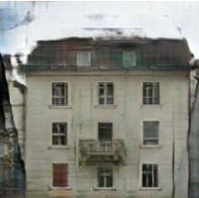
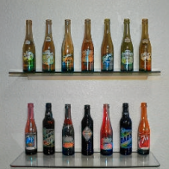
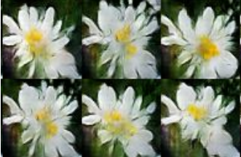
Output Matrix
Image to Image
Colorization:
Ref: https://arxiv.org/pdf/1611.07004v1.pdf
Text to Image
“this white and yellow flower have thin white petals and a round yellow stamen”
ref: https://arxiv.org/pdf/1605.05396.pdf
Notes:
畫圖
上色

Slide 31
Why Structured Learning Challenging?
One-shot/Zero-shot Learning:
  In classification, each class has some examples.
  In structured learning,
    If you consider each possible output as a “class” ……
    Since the output space is huge, most “classes” do not have any training data.
    Machine has to create new stuff during testing.
    Need more intelligence
Notes:
Typical approach: structured SVM, CRF … they are not deep
Of course, you need to plan in game playing

Slide 32


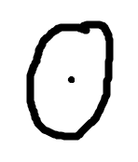




Why Structured Learning Challenging?
Machine has to learn to do planning
  Machine generates objects component-by-component, but it should have a big picture in its mind.
  Because the output components have dependency, they should be considered globally.
Image Generation
Sentence Generation
這個婆娘不是人
九天玄女下凡塵
Notes:
http://bbs.creaders.net/poem/bbsviewer.php?trd_id=859424&language=big5

Slide 33
Structured Learning Approach
Generator
Bottom Up
Top
Down
Generative Adversarial Network (GAN)
Learn to generate the object at the component level
Discriminator
Evaluating the whole object, and find the best one
Notes:
Energy based GAN: https://arxiv.org/abs/1609.03126

Slide 34
Outline
Basic Idea of GAN
GAN as structured learning
Can Generator learn by itself?
Can Discriminator generate?
A little bit theory

Slide 35














Generator
NN
Generator
code
code
code
vectors
code:
$$\left[\begin{aligned}0.1 \\ −0.5\end{aligned}\right]$$
$$\left[\begin{aligned}0.1 \\ 0.9\end{aligned}\right]$$
$$\left[\begin{aligned}0.2 \\ −0.1\end{aligned}\right]$$
$$\left[\begin{aligned}0.3 \\ 0.2\end{aligned}\right]$$
(where does they come from?)
Image:
As close as possible
NN
Generator
$$\left[\begin{aligned}0.1 \\ 0.9\end{aligned}\right]$$
image
As close as possible
NN
Classifier
$$\left[\begin{aligned}y_{1} \\ y_{2} \\ ⋮\end{aligned}\right]$$
$$\left[\begin{aligned}1 \\ 0 \\ ⋮\end{aligned}\right]$$
c.f.

Slide 36


Generator
NN
Generator
code
code
code
vectors
code:
$$\left[\begin{aligned}0.1 \\ −0.5\end{aligned}\right]$$
$$\left[\begin{aligned}0.1 \\ 0.9\end{aligned}\right]$$
$$\left[\begin{aligned}0.2 \\ −0.1\end{aligned}\right]$$
$$\left[\begin{aligned}0.3 \\ 0.2\end{aligned}\right]$$
(where does they come from?)
Image:
Encoder in auto-encoder provides the code ☺
NN
Encoder
$$c$$

Slide 37



Auto-encoder
Low
dimension
Compact representation of the input object
NN
Encoder
code
28 X 28 = 784
Learn together
NN
Decoder
Can reconstruct the original object
code
Trainable
NN
Encoder
NN
Decoder
$$c$$

Slide 38


Auto-encoder
As close as possible
NN
Encoder
NN
Decoder
code
= Generator
Randomly generate a vector as code
NN
Decoder
code
Image ?
= Generator

Slide 39




Auto-encoder
(real examples)
2D
NN
Decoder
image
code
NN
Decoder
$$\left[\begin{aligned}1.5 \\ 0\end{aligned}\right]$$
-1.5
1.5
$$\left[\begin{aligned}−1.5 \\ 0\end{aligned}\right]$$
NN
Decoder
Notes:
SOM: http://alaric-research.blogspot.tw/2011/02/self-organizing-map.html

Slide 40

Auto-encoder
(real examples)
-1.5
1.5
Notes:
SOM: http://alaric-research.blogspot.tw/2011/02/self-organizing-map.html

Slide 41
Auto-encoder
NN
Generator
code
code
code
vectors
code:
$$\left[\begin{aligned}0.1 \\ −0.5\end{aligned}\right]$$
$$\left[\begin{aligned}0.1 \\ 0.9\end{aligned}\right]$$
$$\left[\begin{aligned}0.2 \\ −0.1\end{aligned}\right]$$
$$\left[\begin{aligned}0.3 \\ 0.2\end{aligned}\right]$$
(where does them come from?)
Image:
a
NN
Generator
b
NN
Generator
a
b
NN
Generator
0.5x
+ 0.5x
?

Slide 42
Auto-encoder
NN
Encoder
NN
Decoder
input
output
code
= Generator
Variational Auto-encoder
(VAE)
Minimize reconstruction error
m₁
m₂
NN
Encoder
m₃
$$c_{1}$$
input
NN
Decoder
$$σ_{1}$$
exp
+
$$c_{2}$$
output
$$σ_{2}$$
$$c_{3}$$
$$σ_{3}$$
X
$$c_{i}=exp\left(σ_{i}\right)×e_{i}+m_{i}$$
$$e_{1}$$
From a normal distribution
$$e_{2}$$
Minimize
$$e_{3}$$
$$\sum_{i=1}^{3}{\left(exp\left(σ_{i}\right)−\left(1+σ_{i}\right)+{\left(m_{i}\right)}^{2}\right)}$$

Slide 43

What do we miss?
Generated Image
Target
G
as close as possible
It will be fine if the generator can truly copy the target image.
What if the generator makes some mistakes …….
Some mistakes are serious, while some are fine.
Notes:
模仿得不是神韻

Slide 44
What do we miss?
Target
1 pixel error
1 pixel error
我覺得不行
我覺得不行
6 pixel errors
6 pixel errors
我覺得其實可以
我覺得其實可以
Notes:
We don’t have similar problem in regression
http://wiseodd.github.io/techblog/2017/02/09/why-l2-blurry/
We don’t have similar problem in classification

Slide 45
What do we miss?
Each neural in output layer corresponds to a pixel.
Layer L-1
Layer L
……
empty
誰管你
……
ink
……
……
旁邊的，我們產生一樣的顏色
……
我覺得不行
我覺得其實可以
The relation between the components are critical.
Although highly correlated, they cannot influence each other.
Need deep structure to catch the relation between components.

Slide 46



(Variational) Auto-encoder
感謝 黃淞楓 同學提供結果
x₂
G
$$\left[\begin{aligned}z_{1} \\ z_{2}\end{aligned}\right]$$
$$\left[\begin{aligned}x_{1} \\ x_{2}\end{aligned}\right]$$
x₁

Slide 47
Outline
Basic Idea of GAN
GAN as structured learning
Can Generator learn by itself?
Can Discriminator generate?
A little bit theory

Slide 48

Discriminator
Evaluation function, Potential Function, Energy Function …
Discriminator is a function D (network, can deep)
  Input x: an object x (e.g. an image)
  Output D(x): scalar which represents how “good” an object x is
D
D
1.0
0.1
Can we use the discriminator to generate objects?
Yes.

Slide 49
Discriminator
It is easier to catch the relation between the components by top-down evaluation.
This CNN filter is good enough.
我覺得不行
我覺得其實 OK

Slide 50

Discriminator
Suppose we already have a good discriminator D(x) …
Enumerate all possible x !!!
It is feasible ???
How to learn the discriminator?
Notes:
solve it by gradient ascent
This is the basic idea of Deep Dream.

Slide 51
Discriminator - Training
I have some real images
D
D
scalar
1
(real)
scalar
1
(real)
D
D
scalar
1
(real)
scalar
1
(real)
Discriminator only learns to output “1” (real).
Discriminator training needs some negative examples.

Slide 52


Discriminator - Training
Negative examples are critical.
D
D
scalar
1
(real)
scalar
1
(real)
D
D
scalar
0
(fake)
scalar
0
(fake)
D
How to generate realistic negative examples?
0.9
Pretty real

Slide 53

Discriminator - Training
General Algorithm
  Given a set of positive examples, randomly generate a set of negative examples.
  In each iteration
    Learn a discriminator D that can discriminate positive and negative examples.
    Generate negative examples by discriminator D
v.s.
D
Notes:
contrastive
Question 1 and 2 is solved.
Important: if the weight if not update, end the algorithm

Slide 54
Discriminator - Training
object
x
Discriminator D
scalar
D(x)
D(x)
real examples
In practice, you cannot decrease all the x other than real examples.

Slide 55




Discriminator - Training
$$D\left(x\right)$$
real
generated
$$D\left(x\right)$$
In the end ……
$$D\left(x\right)$$
$$D\left(x\right)$$

Slide 56
Structured Learning
Structured Perceptron
Structured SVM
Gibbs sampling
Hidden information
Application: sequence labelling, summarization
Graphical Model
Bayesian Network
(Directed Graph)
Markov Random Field
(Undirected Graph)
Energy-based Model: http://www.cs.nyu.edu/~yann/research/ebm/
Conditional Random Field
Markov Logic Network
Boltzmann Machine
(Only list some of the approaches)
Restricted Boltzmann Machine
Segmental CRF

Slide 57
Generator v.s. Discriminator
Generator
Pros:
  Easy to generate even with deep model
Cons:
  Imitate the appearance
  Hard to learn the correlation between components
Discriminator
Pros:
  Considering the big picture
Cons:
  Generation is not always feasible
    Especially when your model is deep
  How to do negative sampling?

Slide 58

Generator + Discriminator
General Algorithm
  Given a set of positive examples, randomly generate a set of negative examples.
  In each iteration
    Learn a discriminator D that can discriminate positive and negative examples.
    Generate negative examples by discriminator D
v.s.
D
G
=
Notes:
contrastive
Question 1 and 2 is solved.
Important: if the weight if not update, end the algorithm

Slide 59
Benefit of GAN
From Discriminator’s point of view
  Using generator to generate negative samples
From Generator’s point of view
  Still generate the object component-by-component
  But it is learned from the discriminator with global view.
G
=
efficient
Notes:
Learning a bottom up generator and top down evaluation function at the same time

Slide 60



GAN
感謝 段逸林 同學提供結果
VAE
GAN
https://arxiv.org/abs/1512.09300

Slide 61


[Mario Lucic, et al. arXiv, 2017]
FID[Martin Heusel, et al., NIPS, 2017]: Smaller is better
Notes:
Google brain
FIT:
https://arxiv.org/pdf/1706.08500.pdf

Slide 62
Next Time
Preview
  https://youtu.be/0CKeqXl5IY0
  https://youtu.be/KSN4QYgAtao

Slide 63
Outline
Basic Idea of GAN
GAN as structured learning
Can Generator learn by itself?
Can Discriminator generate?
A little bit theory

Slide 64











Generator
$x$: an image (a high-dimensional vector)
A generator G is a network. The network defines a probability distribution $P_{G}$
$$P_{G}\text{(}\text{x}\text{)}$$
$$P_{data}\left(x\right)$$
Normal Distribution
generator
G
$$z$$
$$x=G\left(z\right)$$
as close as possible
$$G^{∗}=arg\min_{G}{Div\left(P_{G},P_{data}\right)}$$
Divergence between distributions $P_{G}$ and $P_{data}$
How to compute the divergence?

Slide 65




Discriminator
$$G^{∗}=arg\min_{G}{Div\left(P_{G},P_{data}\right)}$$
Although we do not know the distributions of $P_{G}$ and $P_{data}$, we can sample from them.
sample
Database
Sampling from $P_{data}$
sample from normal
G
vector
vector
vector
vector
Sampling from $P_{G}$

Slide 66




Discriminator
$$G^{∗}=arg\min_{G}{Div\left(P_{G},P_{data}\right)}$$
: data sampled from $P_{data}$
Using the example objective function is exactly the same as training a binary classifier.
: data sampled from $P_{G}$
Discriminator
train
Example Objective Function for D
$$V\left(G,D\right)=E_{x∼P_{data}}\left[logD\left(x\right)\right]+E_{x∼P_{G}}\left[log\left(1−D\left(x\right)\right)\right]$$
(G is fixed)
Training:
$$D^{∗}=arg\max_{D}{V\left(D,G\right)}$$
The maximum objective value is related to JS divergence.

Slide 67

Discriminator
$$G^{∗}=arg\min_{G}{Div\left(P_{G},P_{data}\right)}$$
: data sampled from $P_{data}$
Training:
: data sampled from $P_{G}$
$$D^{∗}=arg\max_{D}{V\left(D,G\right)}$$
Discriminator
train
small divergence
hard to discriminate
(cannot make objective large)
Discriminator
train
large divergence
easy to discriminate

Slide 68



[Goodfellow, et al., NIPS, 2014]
$$G^{∗}=arg\min_{G}{Div\left(P_{G},P_{data}\right)}$$
$$\max_{D}{V\left(G,D\right)}$$
$$D^{∗}=arg\max_{D}{V\left(D,G\right)}$$
The maximum objective value is related to JS divergence.
Initialize generator and discriminator
In each training iteration:
Step 1: Fix generator G, and update discriminator D
Step 2: Fix discriminator D, and update generator G

Slide 69


Can we use other divergence?
Using the divergence
you like ☺

